Slide 1
System Programs
System Programming can be defined as the act of building Systems Software using System Programming Languages.
According to Computer Hierarchy, one which comes at last is Hardware.
Then it is Operating System, System Programs, and finally Application Programs.
Program Development and Execution can be done conveniently in System Programs.
Some of the System Programs are simply user interfaces, others are complex.
It traditionally lies between the user interface and system calls.

Slide 2
System programs provide an environment where programs can be developed and executed.
Some of them are simply user interface to system calls
System programs also provide a bridge between user interface and system calls.
System programs act as a part of the operating system.
System programs reside just above in computer hierarchy.
There are various types of system programs
File management
Status information
File modification
Programming-Language support
Program Loading and Execution
Communication

Slide 3
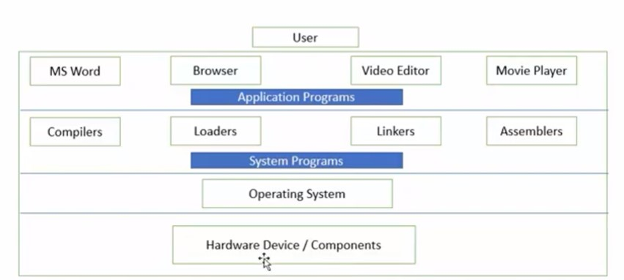
Computer hierarchy

Slide 4
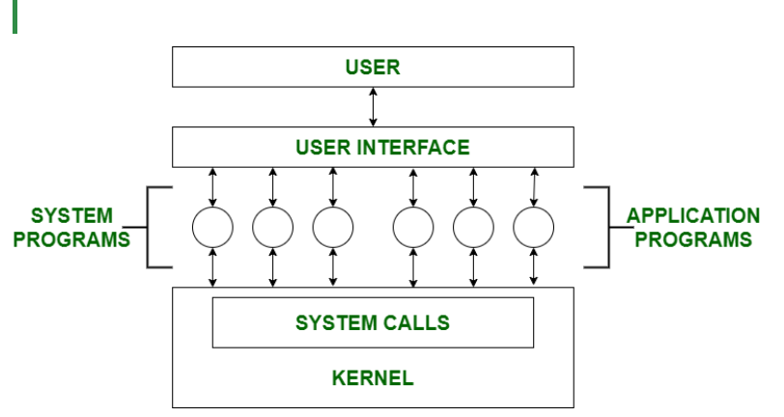

Slide 5
File Management –
A file is a collection of specific information stored in the memory of a computer system.
File management is defined as the process of manipulating files in the computer system, its management includes the process of creating, modifying and deleting files.
It helps to create new files in the computer system and placing them at specific locations.
It helps in easily and quickly locating these files in the computer system.
It makes the process of sharing files among different users very easy and user-friendly.
It helps to store files in separate folders known as directories.
These directories help users to search files quickly or to manage files according to their types of uses.
It helps users to modify the data of files or to modify the name of files in directories.

Slide 6
Status Information –
Information like date, time, amount of available memory, or disk space is asked by some users.
Others providing detailed performance, logging, and debugging information which is more complex.
All this information is formatted and displayed on output devices or printed.
Terminal or other output devices or files or a window of GUI is used for showing the output of programs.

Slide 7
File Modification –
For modifying the contents of files we use this.
For Files stored on disks or other storage devices, we used different types of editors.
For searching contents of files or perform transformations of files we use special commands.
Programming-Language support –
For common programming languages, we use Compilers, Assemblers, Debuggers, and interpreters which are already provided to users.
It provides all support to users.
We can run any programming language. All languages of importance are already provided.

Slide 8
Program Loading and Execution –
When the program is ready after Assembling and compilation, it must be loaded into memory for execution.
A loader is part of an operating system that is responsible for loading programs and libraries.
It is one of the essential stages for starting a program.
Loaders, relocatable loaders, linkage editors, and Overlay loaders are provided by the system.

Slide 9
Communications –
Virtual connections among processes, users, and computer systems are provided by programs.
Users can send messages to another user on their screen, User can send e-mail, browsing on web pages, remote login, the transformation of files from one user to another.
These services are provided by the user because by using this number of devices communicates with each other by the help of device or wireless and communication is necessary for the operating system.

Slide 10
Some examples of system program in O.S. are –
Windows 10
Mac OS X
Ubuntu
Linux
Unix
Android
Anti-virus
Disk formatting
Computer language translators

Slide 11
Operating system design and implementation
It is quite complicated to define all the goals and specifications of the operating system while designing it.
The design changes depending on the type of the operating system i.e if it is batch system, time shared system, single user system, multi user system, distributed system etc.
There are basically two types of goals while designing an operating system.
These are −

Slide 12
User Goals
The operating system should be convenient, easy to use, reliable, safe and fast according to the users.
However, these specifications are not very useful as there is no set method to achieve these goals.
System Goals
The operating system should be easy to design, implement and maintain.
These are specifications required by those who create, maintain and operate the operating system.
But there is not specific method to achieve these goals as well.

Slide 13
Operating System Mechanisms and Policies
There is no specific way to design an operating system as it is a highly creative task.
However, there are general software principles that are applicable to all operating systems.
A subtle difference between mechanism and policy is that mechanism shows how to do something and policy shows what to do.
Policies may change over time and this would lead to changes in mechanism.
So, it is better to have a general mechanism that would require few changes even when a policy change occurs.

Slide 14
For example - If the mechanism and policy are independent, then few changes are required in mechanism if policy changes.
If a policy favors I/O intensive processes over CPU intensive processes, then a policy change to preference of CPU intensive processes will not change the mechanism.

Slide 15
Implementation
Once an operating system is designed, it must be implemented.
Because operating systems are collections of many programs, written by many people over a long period of time, it is difficult to make general statements about how they are implemented.
Early operating systems were written in assembly language.
Now, most are written in higher-level languages such as C or C++, with small amounts of the system written in assembly language.
In fact, more than one higher level language is often used.
The lowest levels of the kernel might be written in assembly language and C.

Slide 16
Higher-level routines might be written in C and C++, and system libraries might be written in C++ or even higher-level languages.
Android provides a nice example: its kernel is written mostly in C with some assembly language.
Most Android system libraries are written in C or C++, and its application frameworks—which provide the developer interface to the system—are written mostly in Java.

Slide 17
Advantages of Higher Level Language
The code can be written faster, is more compact, and is easier to understand and debug.
In addition, improvements in compiler technology will improve the generated code for the entire operating system by simple recompilation.
Finally, an operating system is far easier to port to other hardware if it is written in a higher-level language.
This is particularly important for operating systems that are intended to run on several different hardware systems, such as small embedded devices, Intel x86 systems, and ARM chips running on phones and tablets.

Slide 18
Disadvantages of Higher Level Language
Using high level language for implementing an operating system leads to a loss in speed and increase in storage requirements.
However in modern systems only a small amount of code is needed for high performance, such as the CPU scheduler and memory manager.
Also, the bottleneck routines in the system can be replaced by assembly language equivalents if required.

